Slide 1
Background
There have never been so many young people struggling with mental illness as there are today & there is unfortunately no such thing as a vaccine for mental health problems.
Both before & still during the current pandemic there has been a significant lack of offerings for children & youths who express a need for help with their mental health. As a result, most people suffer from mental illness for far too long, & far too many are not recognized before it is to late.
The support offerings available today do not meet the needs of our modern society.
Below are just a few of the eye-opening statistics that highlight the size of the crisis we face in Norway:
Every other day we lose a young person to suicide in Norway, & for every person that commits suicide there are 10 who attempt to take their own life (source: Dødsårsaksregisteret - Helsedata.no)
7 out of 10 young people are lonely (source: Ny rapport: 7 av 10 ungdom er ensomme - Røde Kors (rodekors.no)
Experienced feelings of happiness & life quality amongst young people have fallen by 14% percentage points since 2009 (source: Forskning viser at ungdom har blitt mindre lykkelige på ti år – NRK Trøndelag)
The waiting list for psychologist services are on average 30 weeks & many places in Norway lack this type of service In their municipalities or towns (source: Tre av fire psykologer har minst et halvt års ventetid – VG)

Slide 2
About Mental Helse Ungdom
Mental Helse Ungdom (Youth Mental Health Norway) is a member-based interest organization for children & young people up to 36 years. We work for increased transparency around mental health, prevention of mental illness & for a better mental health service.
Q: Whats Our Goal?
Our goal is for all children & young people in Norway to have the best possible mental health. We want to break down the stigma around mental health, put it on equal footing with physical health & make it a priority for the people in power. The most important tool we have available to us are the experiences of our young members. We seek to bring awareness & visibility to these experiences in order to contribute to the development of a better help system for mental health. Through our local teams we facilitate activities, growing of networks & social policy work. The work of strengthening and safeguarding the members' resources & recruiting new ones is an ongoing process.
Q: What do we stand for?
Our key values ​​are Courage, Openness and Equality. In order to create a society where everyone can have the best possible mental health, Mental Health Youth has a wide range in our policy. Here you can read the main points of our policy and download our program of principles: https://mentalhelseungdom.no/om-mental-helse-ungdom/var-politikk/
Q: How Do We Work?
We want to be a clear voice that works to ensure that everyone can have the best possible mental health. We strive to do this by establishing platforms for cooperation between members, relatives, the support system & wider society, we want to ensure that everyone gets their rights and opportunities safeguarded.
Q: What does our work look like?
From offering a free online chat service, to running, climbing or boxing courses we have many initiatives that we are proud of. You can read more about some of them here: https://mentalhelseungdom.no/vare-prosjekter/

Slide 3
The Challenge
The most important voices to listen to, when solving problems for young people, should be the voices of young people themselves. But how can we ensure that these voices are heard?
At Youth Mental Health we believe we can only do so by encouraging mass youth participation & bringing them together under an organisation that champions their views.
We seek to engage & represent these voices, lending them a platform where their voices have a greater chance to be considered by those with the power, to effect real & meaningful change in society.
For our organisation to be truly considered & listened to, we need to be many who shout loudly. Having a visibly large number of registered members is the key to this.
Our challenge today is that we have low awareness amongst the youth population. The result is a low membership base – especially when considered versus the number of people that we aim to represent (hundreds of members vs millions of people living in Norway today under the age of 36!).
We need to let youths know that (i) we exist & (ii) that if they care about their own mental health as well as that of their friends, classmates, colleagues & a stranger in the street, they should JOIN our organisation.
With the help of our members, young voices can then become stronger in the political landscape. Our views as an organisation will have greater weight in the media, & together we can push for real change in Norway!!!

Slide 4
Brief Specifics - PR
Objective
Create a PR campaign that supports Mental Helse Ungdom’s overall objectives, and specifically helps:
Raise awareness of mental heallth among youth in general, and of the organization in particular
Drive engagement and interest in becoming a member or a donor
Target Audience:
1. Citizens aged aged 13-36 years throughout Norway (potential members)
Citizens aged 37+ (potential donors), political stakeholders, opinion leaders, media
Deliverables
Creative ideas!
Max 10 slides (Powerpoint or Keynote).

Slide 5
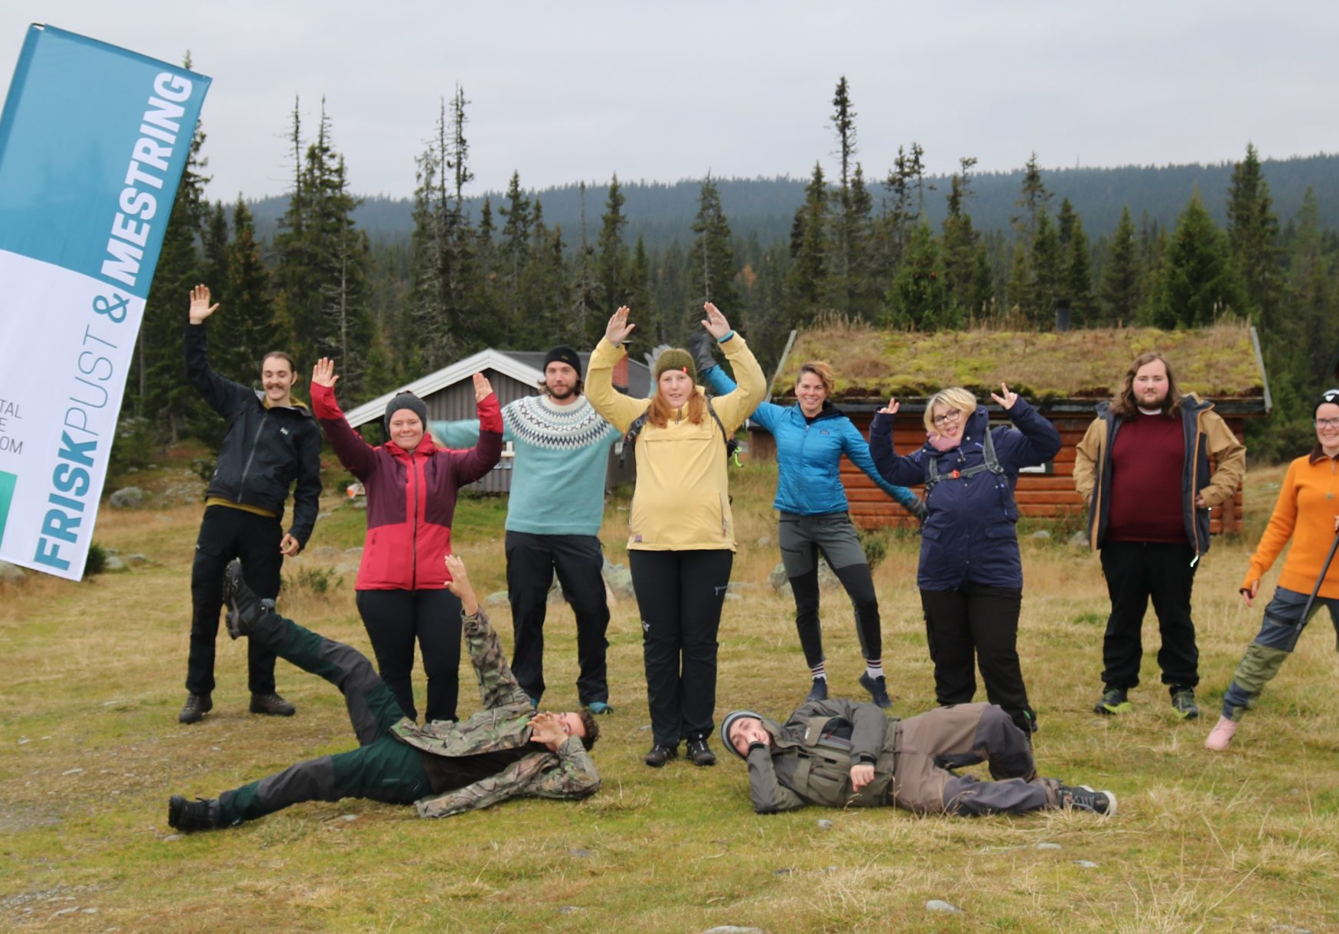
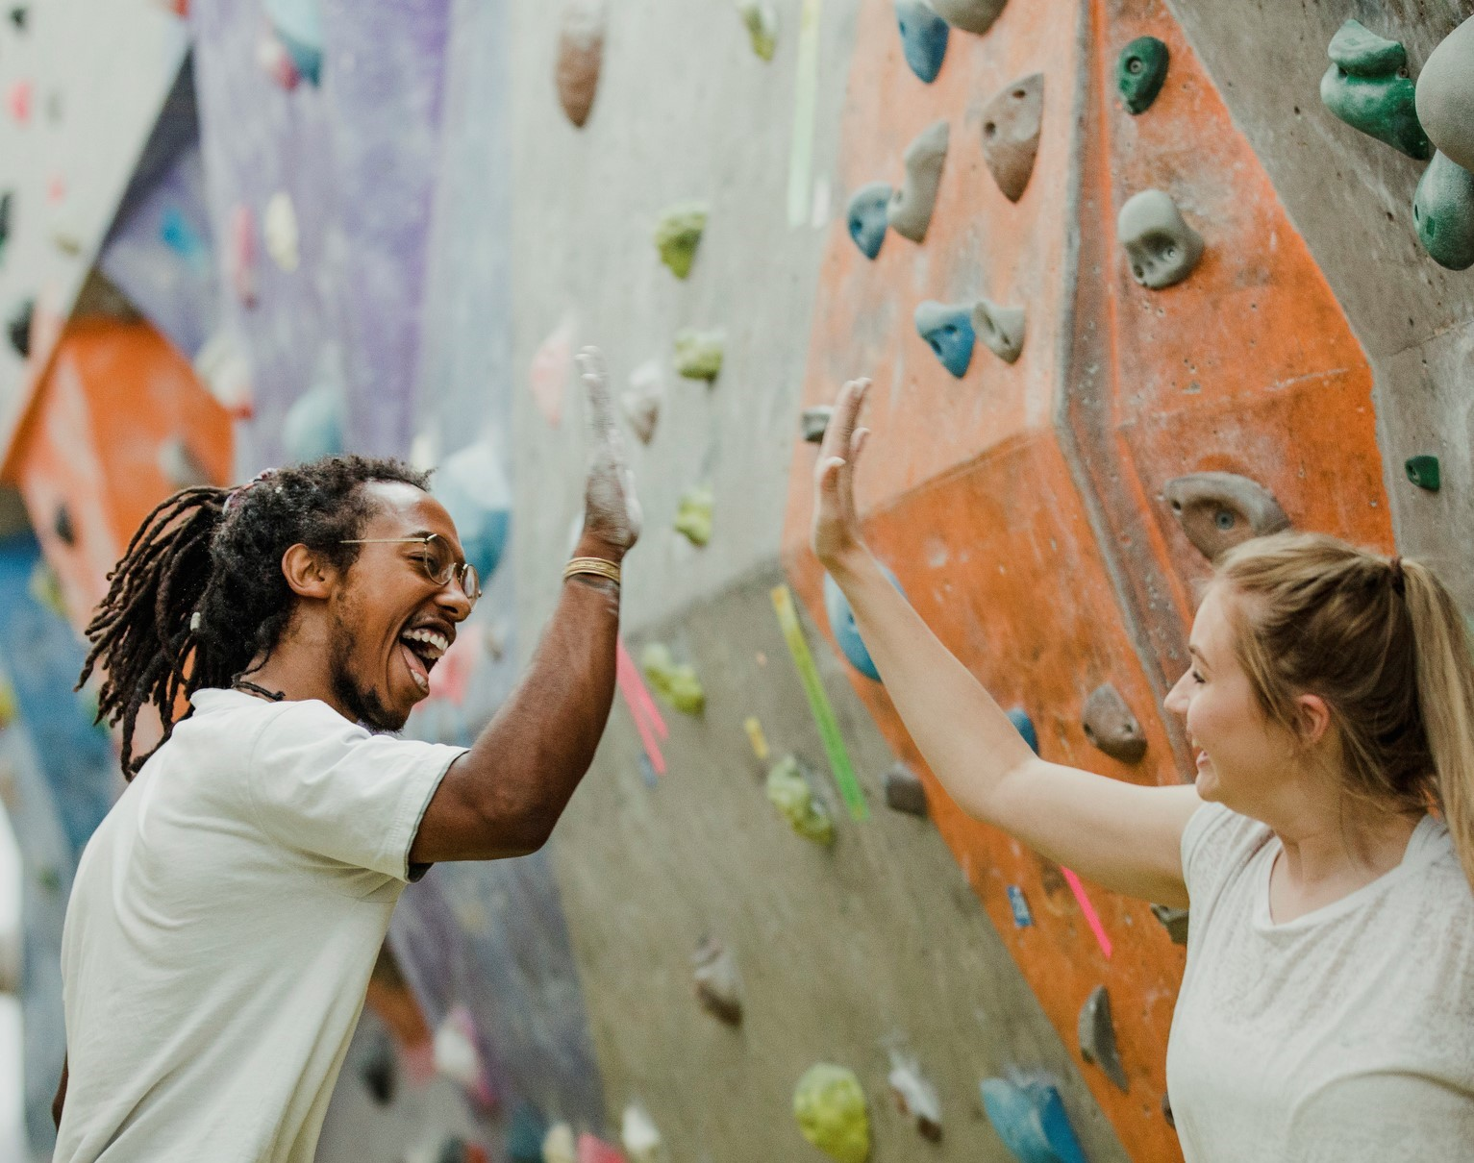
Additional Info: The Membership
Whilst we do not wish for your work to focus on the specific benefits of an MHU membership, for your understanding we offer the following benefits & services to our members:
SUMMER CAMP
FRESH AIR
Every year we arrange summer camps for our members
e.g. the past year we arranged several trips to Åkersetra in Ringsaker municipality.
INSPIRATION IN THE POST
POLITICAL INFLUENCE
Our members-only magazine is sent out 4 times a year.
We take members views on what MHU should work towards politically.
A ROLE AT YOUR MEETING PLACE
LOW MEMBERSHIP COST
For example as a leader, cashier ++
It costs just 60kr per year to be a member
REDUCED COST AT EPSYK.no
BE PART OF A LOCAL TEAM
A digital psychologist service (link)
Local teams arrange engaging activities & meeting places for members to take part in.

